Slide 1
English Writing II
Week 6 Revising your language

Slide 2
Lesson plan
Review of the outline writing
Close-up reading
In-class writing exercises
Homework

Slide 3
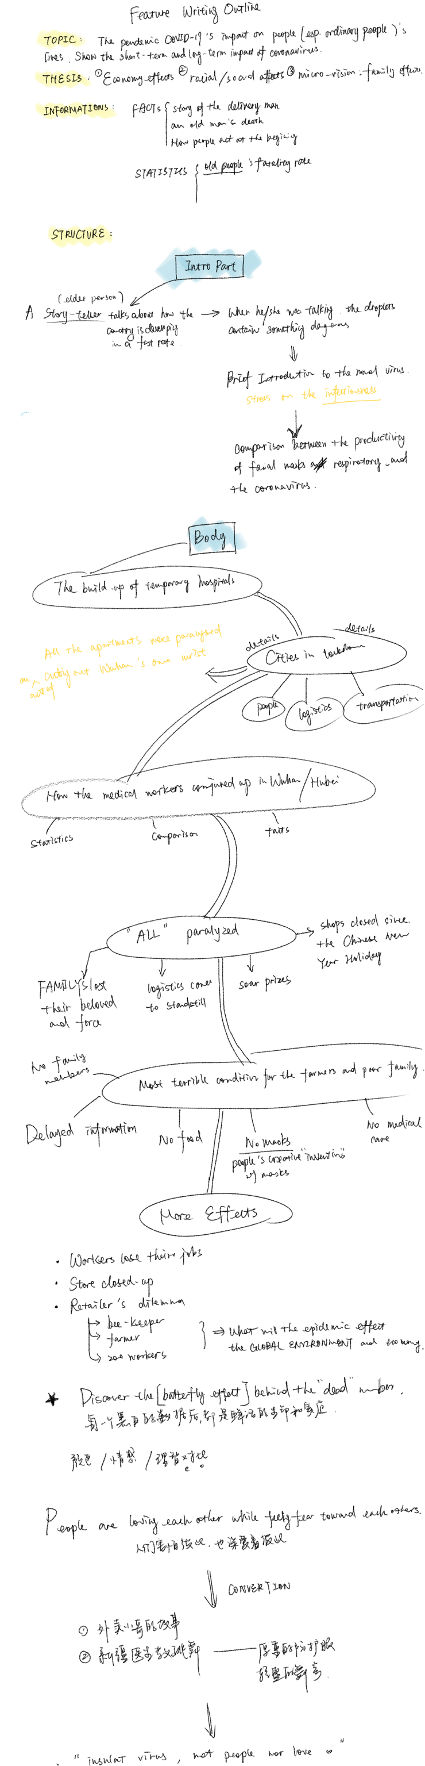

Slide 4
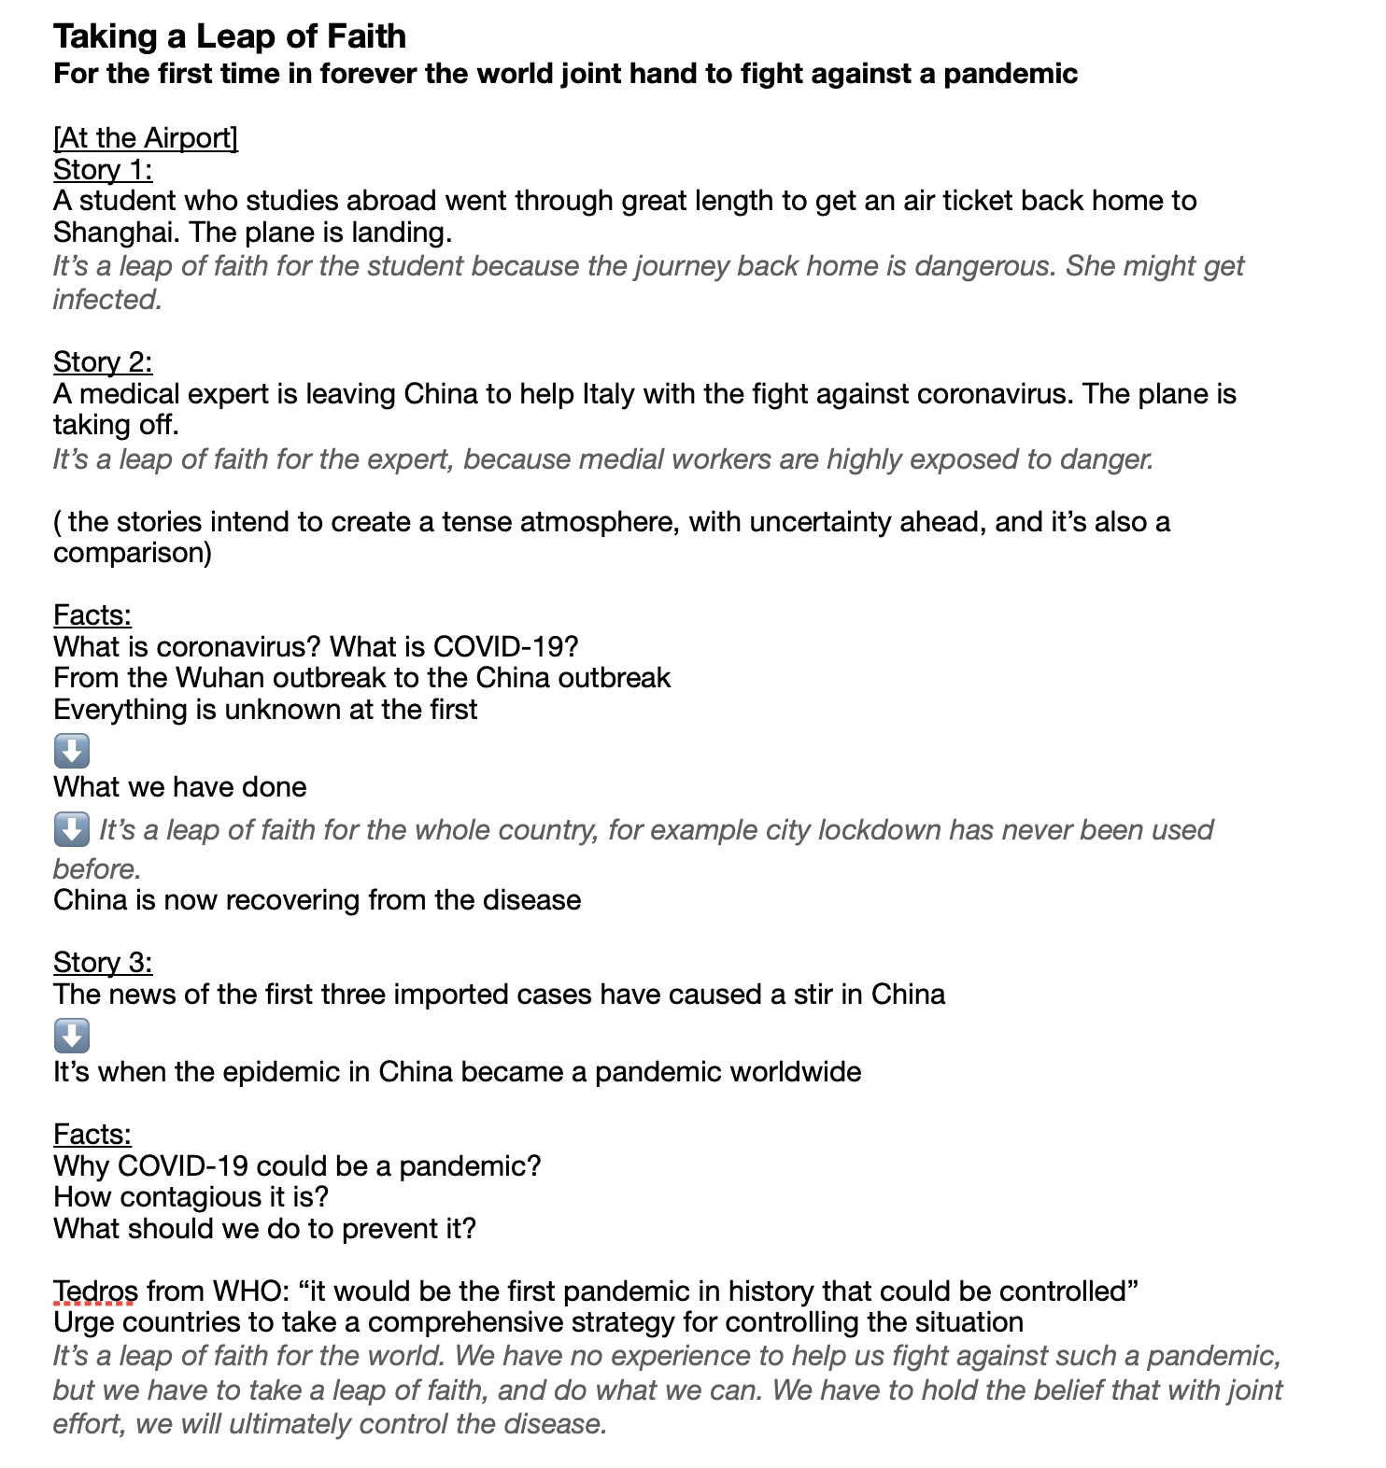
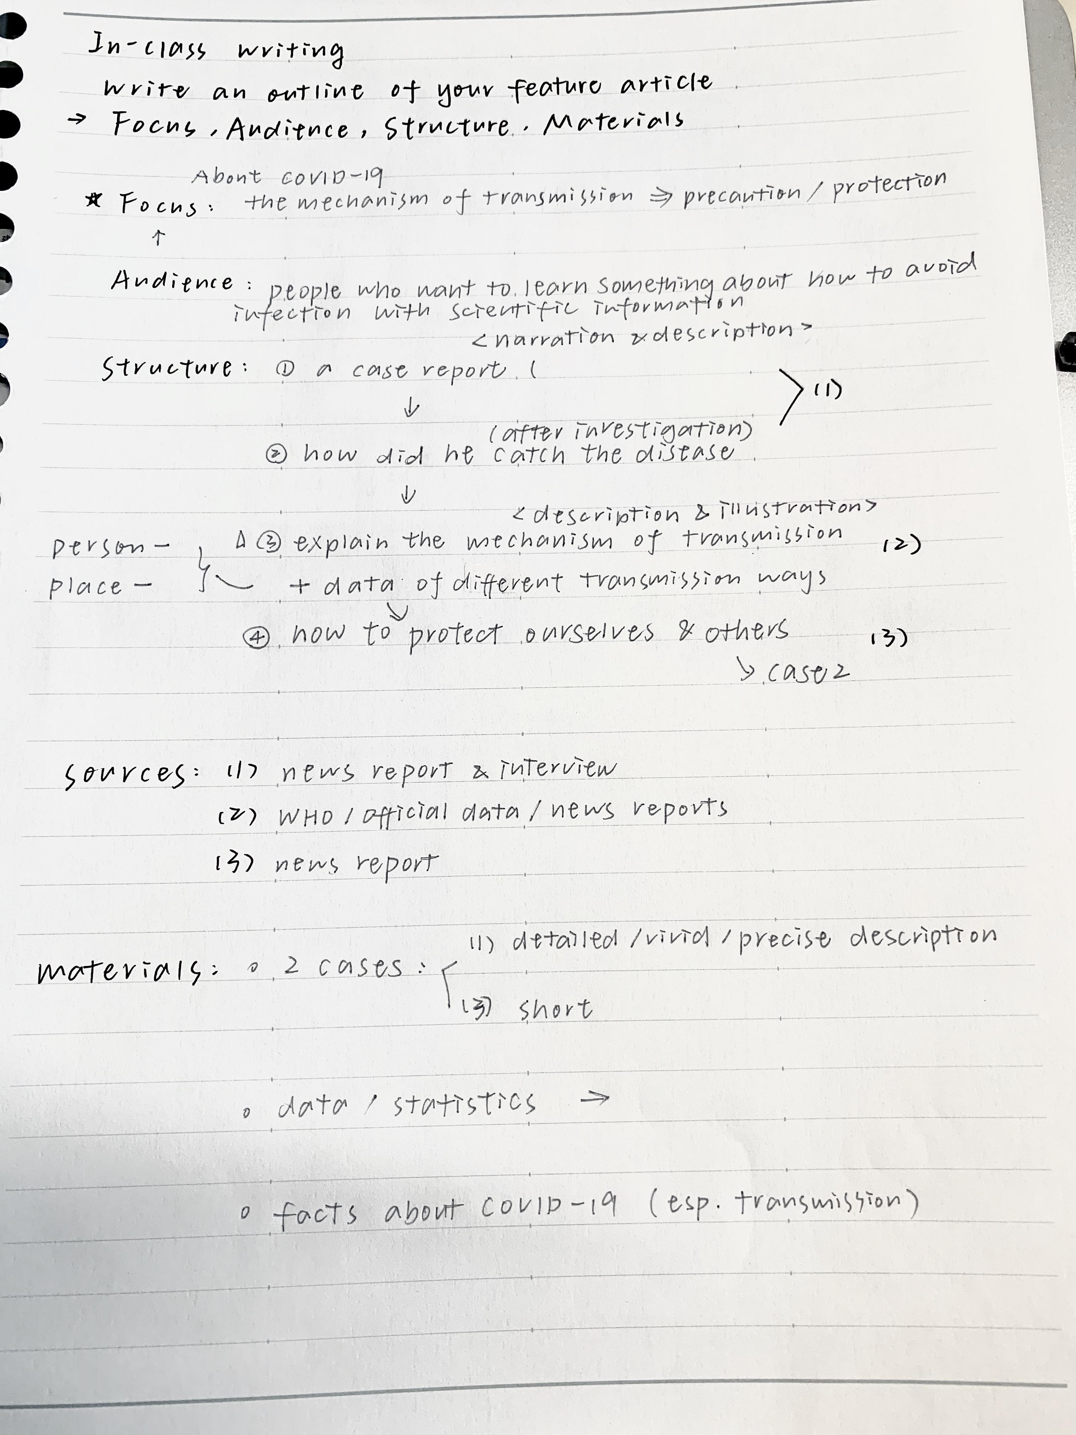

Slide 5
Review of outline writing
outline (1).docx

Slide 6
Some problems…
China vs. the world?
People (normal/ordinary) vs. society?
What should “WE” do?
First-hand vs. second-hand information
Vividness vs. details
“In my opinion” vs. depths

Slide 7
Close-up reading and in-class writing
Close-up reading (Week 6).docx

Slide 8
Useful words and expressions
In truth, malaria now affects more people than ever before.
This year malaria will strike up to a half billion people.
The outcry over this epidemic, until recently, has been muted.
Several distinctly unprosperous regions have reached the brink of total malarial collapse.
Much of the aid is going to a few hard-hit countries …

Slide 9
Useful words and expressions
…, a vaccine that would curb the disease for good.
If these nations can beat back the disease, they’ll serve as templates for the global antimalarial effort.
Scientists at the world’s high-tech labs ponder the secrets of the parasite; aid agencies solicit donations; pharmaceutical companies organize drug trials.

Slide 10
Project 1: A COVID-19 Story
A feature article (in-depth, vivid, non-fiction)
800-1000 words
Reliable data, opinions and hard facts
Use of analogy for exposition
DDL: midnight April 8

